Slide 1
BIC & CUBIC
Ahmed El-Hassany
CISC856: CISC 856 TCP/IP and Upper Layer Protocols
Slides adopted from: Injong Rhee, Lisong Xu

Slide 2
Agenda
What?
Why?
How?
Can we do better?

Slide 3
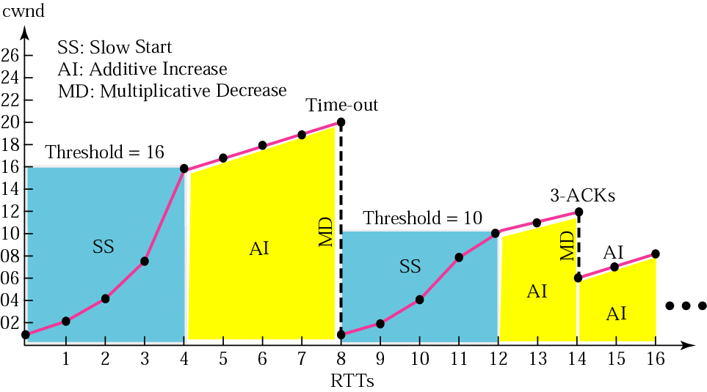
Congestion example

Slide 4
AIMD (Additive Increase Multiplicative Decrease)
AIMD increases cwnd by a larger number, say 32, instead of 1 per RTT.
After a packet loss, AIMD decreases cwnd by 1/8, instead of 1/2
cwnd = cwnd + 1
cwnd = cwnd + 32
cwnd = cwnd * (1-1/2)
cwnd = cwnd * (1-1/8)
Packet loss
Packet loss
Packet loss
Packet loss
TCP
cwnd
Slow start
Congestion avoidance
Time (RTT)

Slide 5
What
How much time is needed increase cwnd of a 10Gbps from half utilization to full utilization?
1500-byte PDU
100 ms RTT
SLOW
Full utilization cwnd = 10Gbps/1500byte ~=83333
Half utilization cwnd = 83333/2 = 41666.5
Remember cwnd is increased by 1 for each RTT
41667 RTT is needed to fully utilized the link
41667 RTT * 100ms(RTT time) = 69.44minutes

Slide 6


What
y₁ ms
z₁ ms
Unfair
y₂ ms
x ms
z₂ ms
y₁ + x + z₁ >> y₂ + x + z₂

Slide 7
Definitions
Bandwidth-Delay Product: Maximum amount of data on the network circuit at any given time
Links capacity (bytes/sec)* end-to-end delay (sec)
TCP Fairness: a new protocol receive no larger share of the network than a comparable TCP flow.
TCP-friendliness: defines whether a protocol is being fair to TCP.

Slide 8
What
TCP slowly increases its congestion window (cwnd) for every RTT.
TCP reduces cwnd by half at a lost event.

Slide 9
Response Function of TCP
Response function of TCP is the average throughput of a TCP connection in terms of the packet loss probability, the packet size, and the round-trip time.
Response Function of TCP is :
R : Average Throughput
MSS: Packet Size
RTT: Round-Trip Time
P : Packet Loss Probability
J. Padhye, V. Firoio, D. Towsley, J. Kurose, "Modeling TCP Throughput: a Simple Model and its Empirical Validation", Proceedings of SIGCOMM 98
Notes:
Usually, we study the performance of TCP using its response function, which is defined as the average throughput of TCP in terms of packet loss probability.
Here is the response function of TCP. In this function, MSS is the packet size, RTT is the round trip time, and p is the packet loss probability. From this function, we can see that the throughput of TCP depends on the packet size, the round-trip time, and the packet loss probability. In order to increase the throughput of TCP, we can either increase the packet size, or decrease the round trip time, or decrease the packet loss probability. Usually for a TCP connection, the packet size and round-trip time are fixed. Therefore, the throughput of a TCP connection mainly depends on the packet loss probability.

Slide 10
Why (Response Function of TCP)
10Gbps requires a packet loss rate of 10⁻¹⁰, or correspondingly a link bit error rate of at most 10⁻¹⁴, which is an unrealistic (or at least hard) requirement for current networks
Using Log-Log scale, Assuming 1250-Byte packet size, and 100ms RTT
Notes:
In this figure, we show how the throughput changes as we vary the packet loss probability. Note that the figure is shown in log-log scale. We can see that as the packet loss probability decreases, the TCP throughput increases. Assume the packet size is 1000 Bytes, and the RTT is 100ms, then TCP achieves the 10Gbps throughput when the packet loss probability is around 10-10.which corresponds to a link BER of 10-14. which is an unrealistic requirement for current networks. That is, in the current networks, it is impossible for TCP to achieve 10Gbps throughput.

Slide 11
A Search Problem
A Search Problem
BIC consider the increase part of congestion avoidance as a search problem, in which a connection looks for the available bandwidth by comparing its current throughput with the available bandwidth, and adjusting cwnd accordingly.
Q: How to compare R with A?
R = current throughput
= cwnd/RTT
A = available bandwidth
A: Check for packet losses
No packet loss: R <= A
Packet losses : R > A
How does TCP find the available bandwidth?
Linear search
while (no packet loss){
cwnd++;
}

Slide 12
Linear Search
Available Bandwidth

Slide 13
BIC: Binary Search with Smax and Smin
BIC - Binary search
while (Wmin <= Wmax){
inc = (Wmin+Wmax)/2 - cwnd;
if (inc > Smax)
inc = Smax;
else if (inc < Smin)
inc = Smin;
cwnd = cwnd + inc;
if (no packet losses)
Wmin = cwnd;
else
break;
}
Wmax: Max Window
Wmin: Min Window
Smax: Max Increment
Smin: Min Increment

Slide 14
Binary Search with Smax and Smin
Available Bandwidth
Wmax
Smin
Smax
Wmin

Slide 15
Setting Smax
Response Function of BIC on high-speed networks
Bandwidth scalability
Bandwidth scalability of BIC depends only on Smax
RTT Fairness of BIC on high-speed networks is the same as that of AIMD

Slide 16
Setting Smin
Response Function of BIC on low-speed networks
TCP-friendliness of BIC depends only on Smin
TCP friendliness

Slide 17
Response Functions
Bandwidth scalability
RTT Fairness
TCP-Friendliness
Notes:
Finally, here is the response function of BIC. Which has a good scalability, a good TCP-friendliness, and a good RTT Fairness in high-speed networks.

Slide 18
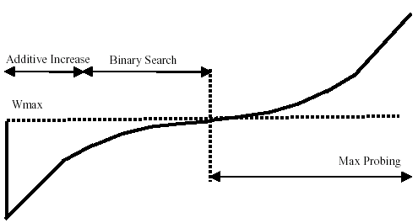
In Summary BIC function
BIC overall performs very well in evaluation of advanced TCP stacks on fast long-distance production.
BIC (also HSTCP & STCP) growth function can be still aggressive for TCP especially under short RTTs or low speed networks.

Slide 19
Thinking Out of The Box
Make window size growth function independent from RTT.
Use the elapsed real-time since the last loss event.
Goals
TCP friendly
RTT fair
Co-existing flows with different RTTs are treated fairly
Efficient use of available bandwidth

Slide 20
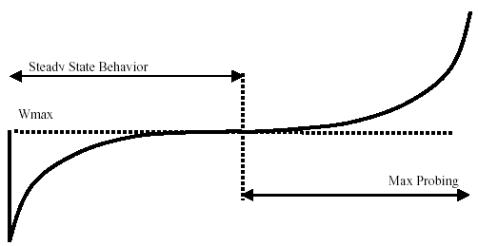


The CUBIC function
accelerate
slow down
accelerate
where C is a scaling factor, t is the elapsed time from the last window reduction, and β is a constant multiplication decrease factor

Slide 21
CUBIC Algorithm
If (received ACK && state == cong avoid)
Compute W_{cubic}(t+RTT).
If cwnd < W_{TCP}
CUBIC in TCP mode
If cwnd < W_{max}
CUBIC in concave region
If cwnd > W_{max}
CUBIC in convex region

Slide 22
TCP Mode
Detailed derivation of this equation is in Section 3.3 in CUBIC paper

Slide 23
Concave Region
Detailed derivation of this equation is in Section 3.4 in CUBIC paper

Slide 24
Convex Region
cwnd > Wmax
New bandwidth might be available
Use the same window growth function.
Detailed derivation of this equation is in Section 3.5 in CUBIC paper

Slide 25
Packet Loss Event
If cwnd < Wmax and fast_convergence
Wmax = cwnd * ((2-β)/2)
Else:
Wmax = cwnd
ssthread = cwnd = cwnd*(1-β)

Slide 26


Testbed (Dummynet) Setup
1 Gbps link
FreeBSD
Linux
High-Speed TCP Variants :
e.g. CUBIC, BIC, FAST, HSTCP, STCP
Setting RTT for each path between Senders and Receiver
RTT for Background Traffic : Exponential Distribution (Next Slide)
Sender 1
Bottleneck Point : 800 Mbps
High-Speed TCP
or TCP SACK
Receiver
Sender 2
Router 1
Router 2
Background Traffic Generator 1
Background Traffic Generator 2
Background Traffic Generation
(Next Slide)
Background Traffic Generation
(Next Slide)

Slide 27
TCP Friendliness (cont.)
Dummynet Testbed : RTT 5ms & 800 Mbps, 100% router buffer of the BDP with 80 ~ 200 Mbps background traffic
80 Mbps
Background traffic
200 Mbps
Link Utilization (%)
TCP Friendliness on short RTT - 5ms

Slide 28
TCP Friendliness (cont.)
Dummynet Testbed : RTT 10ms & 800 Mbps, 100% router buffer of the BDP with 80 ~ 200 Mbps background traffic
80 Mbps
Background traffic
200 Mbps
Link Utilization (%)
TCP Friendliness on short RTT - 10ms

Slide 29
TCP Friendliness (cont.)
Dummynet Testbed : RTT 100ms & 800 Mbps, 100% router buffer of the BDP with 80 ~ 200 Mbps background traffic
80 Mbps
Background traffic
200 Mbps
Link Utilization (%)
TCP Friendliness on long RTT - 100ms

Slide 30
TCP Friendliness (cont.)
Dummynet Testbed : RTT 200ms & 800 Mbps, 100% router buffer of the BDP with 80 ~ 200 Mbps background traffic
80 Mbps
Background traffic
200 Mbps
Link Utilization (%)
TCP Friendliness on long RTT - 200ms

Slide 31
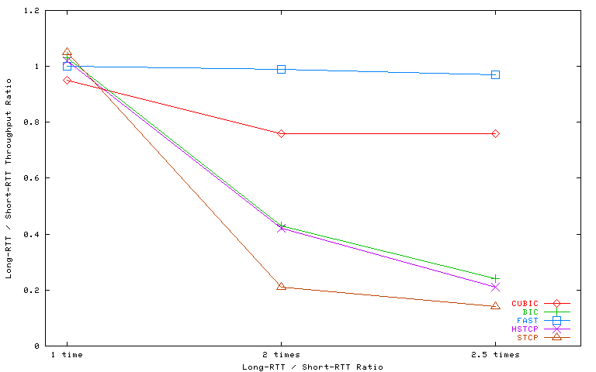
RTT Fairness
Dummynet testbed : RTT 40, 120, 240 ms & 800 Mbps, Router buffer: 50% of the BDP with 200 Mbps background traffic

Slide 32
Can We do better?
?

Slide 33
References
Sangtae Ha, Injong Rhee, and Lisong Xu. CUBIC: a new TCP-friendly high-speed TCP variant. SIGOPS Oper. Syst. Rev. 42, 5 (July 2008)
Lisong Xu, Khaled Harfoush, and Injong Rhee, Binary Increase Congestion Control for Fast, Long Distance Networks,Infocom, IEEE, 2004

